Slide 1

Welcome to Developing and Deploying Intelligent Chat Bots
Instructor: Micheleen Harris
Data Scientist @ Microsoft
Handouts at aka.ms/botedu-hack

Slide 2
Technologies covered
Microsoft Cognitive Services
Microsoft Bot Framework

Slide 3
What you’ll know at the end of Cognitive Services section
Understand the types of intelligent services offered by Microsoft Cognitive Services
Be able to talk about and use the Language Understanding and Intelligent Service API
Be able to talk about and use the Computer Vision API
Be able to talk about and use the Bing News Search API

Slide 4
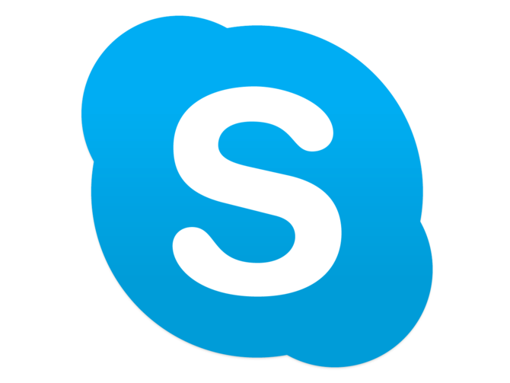





Cognitive Services power products across Microsoft
Intelligence powers our products
Vision
Speech
Language
Knowledge
Search
Notes:
Cognitive Services are coming out of as well as being consumed by groups across Microsoft including our products as well as Microsoft Research and engineering
e.g. Text Analytics under Language has come from engineers in Azure – Microsoft’s cloud offering
e.g. the Knowledge Exploration Service for building custom knowledge bases has come out of Microsoft Research
e.g. Speech to text has come out of Bing

Slide 5

Microsoft Cognitive Services preview
Vision
Computer Vision | Emotion | Face | Video | Content Moderator
Cognitive Services
Give your solutions a human side
Speech
Custom Speech | Speaker Recognition | Speech
Language
Bing Spell Check | Language Understanding | Linguistic Analysis | Text Analytics | Web Language Model | Translator Text and Speech
Knowledge
Academic Knowledge | Entity Linking | QnA Maker Knowledge Exploration | Recommendations
Search
Bing Auto Suggest | Bing Image Search | Bing News Search | Bing Video Search | Bing Web Search
Notes:
At Microsoft, we’ve been offering APIs for a very long time across the company. In delivering Microsoft Cognitive Services API, we started with 4 at /build (2015); added 7 more December 2015, and today we have 24 APIs in our collection.
Cognitive Services are available individually or as a part of the Cortana Intelligence Suite, formerly known as Cortana Analytics, which provides a comprehensive collection of services powered by cutting-edge research into machine learning, perception, analytics and social bots.
These APIs are powered by Microsoft Azure.
Developers and businesses can use this suite of services and tools to create apps that learn about our world and interact with people and customers in personalized, intelligent ways.
Some great scenarios for all of the cognitive services can be found on this wiki: https://github.com/Azure/bot-education/wiki/Cognitive-Services-Scenarios

Slide 6
Cognitive Services Scenarios
Emotion detection at retail displays
Facial identification for missing children
Sentiment analysis to find out how customers feel
Natural language processing to collect what medical pain a person has
Speech recognition for a video game with specialized commands
Object recognition to allow the sight-impaired to gain a deeper understanding of surroundings

Slide 8
Language Understanding Intelligent Service (LUIS)
Notes:
https://www.microsoft.com/cognitive-services/en-us/language-understanding-intelligent-service-luis

Slide 9
How to talk about it LUIS Concepts
Intent – aim or goal
Entities – a type or “notion” of person, place or thing
Utterances – the phrase we might use that is added training data
Notes:
Example:
intent – find news on topic and possibly share with another person
entities - We'd like to be able to say what kind of news we are interested in, and also, for sharing, to say who we'd like to share a story with. In order to capture the notion of a news topic, and a recipient for sharing, let's create two entity types: "Topic" and "Recipient".
Utterence – “Get me the news on electric cars and share with Merinda”
We currently support (3/28/2017):
30 entities per application
80 intents per application
Over 2000 utterances per application.

Slide 10
How to understand it LUIS examples
Read me the headlines
Intent: TextToSpeech
Content: NewsHeadlines
Understand what your users are saying
Determines intent
Detects entities
Learns over time
Active and interactive learning
Options to use pre-built, world class models from Bing and Cortana
Play yesterday’s Daily Show
Intent: PlayEpisode
Content: Daily Show
DateTime.date: T-1 Day
Pause for 5 minutes
Intent: PauseDevice
DateTime.duration: 5 Minutes

Slide 11
How to understand it LUIS - Training
When you train a model:
LUIS generalizes from the examples you have labeled (utterances)
Develops code to recognize the relevant intents and entities in the next usage of this model
Define
concepts
Provide
examples
Publish
Active learning
Notes:
Internally, LUIS uses logistic regression classifiers to determine intents, and conditional random fields (CRFs) to determine the entities. The training process results in optimized classifiers and CRFs, referred to as models, that LUIS can use in the future.

Slide 12
How to build it LUIS SDKs
LUIS Portal – web-based UI for training and publishing a model
LUIS has SDKs in the following languages:
Node.js
Python
C#
Java for Android
Also, any language of your choice that can make a REST API call!
Many samples of usage to be found on Cognitive Services site
Notes:
Note on Utterances
If you have unlabeled utterances that your application should handle, they will be available when you edit the application under the "Search" and "Suggest" tabs.
Can link intents to actions in your custom code (consuming the API)
Exporting LUIS app
Can download your work into a JSON file. This lets you share you application with other developers, or check your LUIS application into your version control.
Pre-Built:
LUIS also provides access to pre-built LUIS applications that use many of the same models found in Microsoft Cortana.
SDKs
https://github.com/Microsoft/Cognitive-LUIS-Node.js
https://github.com/Microsoft/Cognitive-LUIS-Python
https://github.com/Microsoft/Cognitive-LUIS-Windows
https://github.com/Microsoft/Cognitive-LUIS-Android
SDK/Samples site:
https://www.microsoft.com/cognitive-services/en-us/SDK-Sample

Slide 13
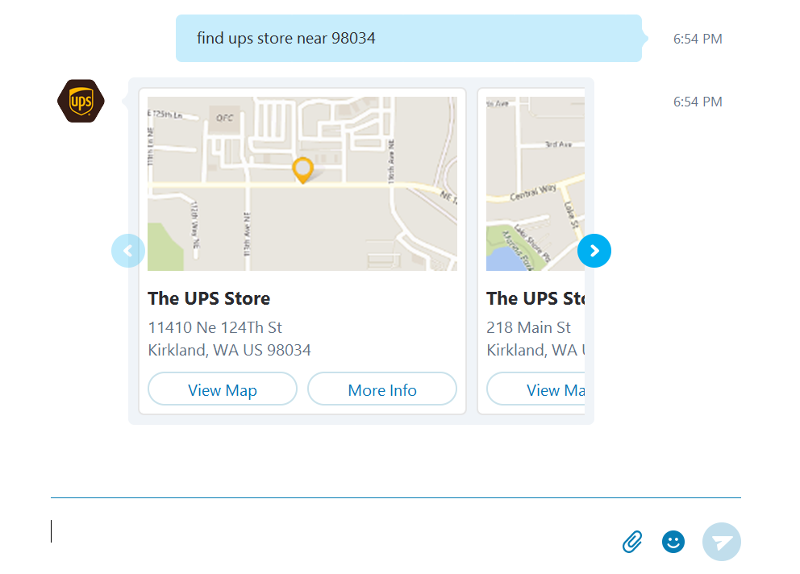
How to consume it LUIS API scenario
Use a bot to find UPS locations or track your UPS package…
Notes:
UPS Bot – uses natural language to help a user find what they need along with other APIs
https://bots.botframework.com/bot?id=UPSBot
More
Bot: (Node.js) https://github.com/Microsoft/BotBuilder-Samples/tree/master/Node/intelligence-LUIS
Bot: (C#) https://github.com/Microsoft/BotBuilder-Samples/tree/master/CSharp/intelligence-LUIS
Cognitive Services site demo: https://www.microsoft.com/cognitive-services/en-us/language-understanding-intelligent-service-luis
See LUIS help at https://luis.ai for more

Slide 15
Computer Vision API
Notes:
https://www.microsoft.com/cognitive-services/en-us/computer-vision-api

Slide 16
How to talk about it CV API modes
Modes for analysis:
Analyze – extraction of visual features (such as tags, colors, faces)
Describe – natural language description
OCR – word recognition
Domain specific – celebrity recognition only currently
Thumbnail – user desired size with regions of interest
Notes:
https://www.microsoft.com/cognitive-services/en-us/Computer-Vision-API/documentation -> details in API Reference

Slide 17
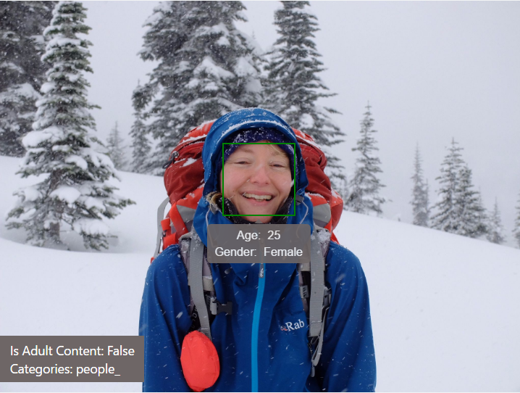
How to understand it Image analysis example
Description | { "type": 0, "captions": [ { "text": "person that is standing in the snow", "confidence": 0.4835140399902179 } ] }
Clip Art Type 0 Non-clipart
Line Drawing Type 0 Non-LineDrawing
Black & White Image False
Categories | [ { "name": "people_", "score": 0.9375 } ]
Faces | [ { "age": 25, "gender": "Female", "faceRectangle": { "width": 288, "height": 288, "left": 874, "top": 557 } } ]
Notes:
Image analyzed with the demo found at https://www.microsoft.com/cognitive-services/en-us/computer-vision-api

Slide 18
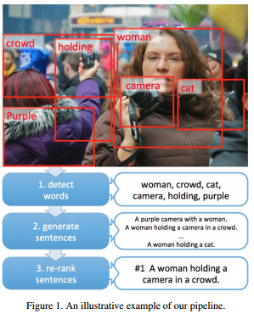
How to understand it Machine Learning models for image captions with CV
Key notes:
sub-regions are used in learned detector
Training of language model captures commonsense knowledge
High likelihood sentences are re-ranked by linear weighting
Fang H. et al. From Captions to Visual Concepts and Back. 2016
Notes:
See paper here: https://www.microsoft.com/en-us/research/wp-content/uploads/2016/02/CVPR15_0866.pdf

Slide 19
How to build it CV tools and samples
CV has SDKs for the following:
Swift
Android (Java)
Windows (C#)
And samples:
Python (Jupyter notebook)
C# (image captioning bot)
Node.js (image captioning bot)
See4Me (Face, Emotion, CV – cross-platform app)
Also, any language of your choice that can make a REST API call!
Notes:
SDKs:
https://github.com/DanilaVladi/Microsoft-Cognitive-Services-Swift-SDK
https://github.com/Microsoft/Cognitive-vision-android
https://github.com/Microsoft/Cognitive-vision-windows
Notebook:
https://github.com/Microsoft/Cognitive-vision-python
Bots:
https://github.com/Microsoft/BotBuilder-Samples/tree/master/Node/intelligence-ImageCaption
https://github.com/Microsoft/BotBuilder-Samples/tree/master/CSharp/intelligence-ImageCaption
See4Me:
https://github.com/DotNetToscana/See4Me
Demos also on CV landing page at: https://www.microsoft.com/cognitive-services/en-us/computer-vision-api

Slide 20

How to consume it CV scenario
Seeing AI: In collaboration with Microsoft Research, Pivothead is bringing "vision" to the visually-impaired.
Notes:
By combining APIs from Microsoft Cognitive Services with the imaging performance and power of Pivothead SMART, a person who is visually-impaired can better understand who and what is going on around them.
http://www.pivothead.com/seeingai/

Slide 22
Bing News Search API
Notes:
https://www.microsoft.com/cognitive-services/en-us/bing-news-search-api

Slide 23
How to talk about it News Search API modes
Search – news articles from a given query
Category – news articles of a given preset category (e.g. science and technology, world, etc.)
Trending topics – trending news articles

Slide 24
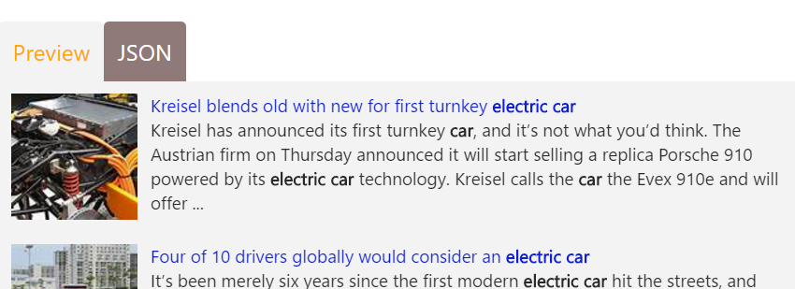
How to understand it News Search API query results
"value":[
{
"name":"Kreisel blends old with new for first turnkey <b>electric</b> <b>car</b>",
"url":"http://www.bing.com/cr?IG=D6DD23EBE8674CCEACD812C7E01635D2&CID=12839B0BFC0666041D1C9156FD596719&rd=1&h=Kt4GVdEhdJSqhkvyli9CS8ecBxljYDwO0cDQhZu3AbU&v=1&r=http%3a%2f%2fwww.motorauthority.com%2fnews%2f1109793_kreisel-blends-old-with-new-for-first-turnkey-electric-car&p=DevEx,5008.1",
"image":{
"thumbnail":{
"contentUrl":"https://www.bing.com/th?id=ON.400B3D6BB595B49192CFC714E71971D5&pid=News",
"width":640,
"height":358
}
},
"description":"Kreisel has announced its first turnkey <b>car</b>, and it’s not what you’d think. The Austrian firm on Thursday announced it will start selling a replica Porsche 910 powered by its <b>electric</b> <b>car</b> technology. Kreisel calls the <b>car</b> the Evex 910e and will offer ...",
…
Notes:
Search the web for news articles. Results include details like authoritative image of the news article, related news and categories, provider info, article URL, and date added.

Slide 25
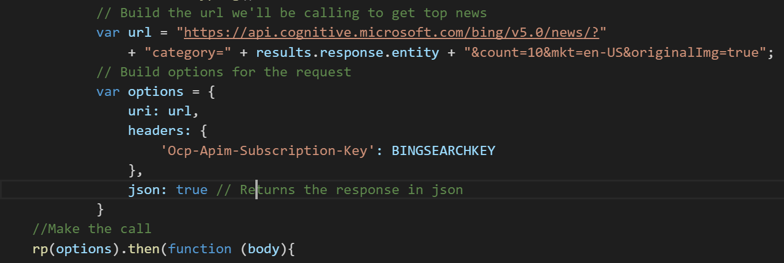
How to build it News Search API call
Call the News Search REST API endpoint in a few lines of code…

Slide 26
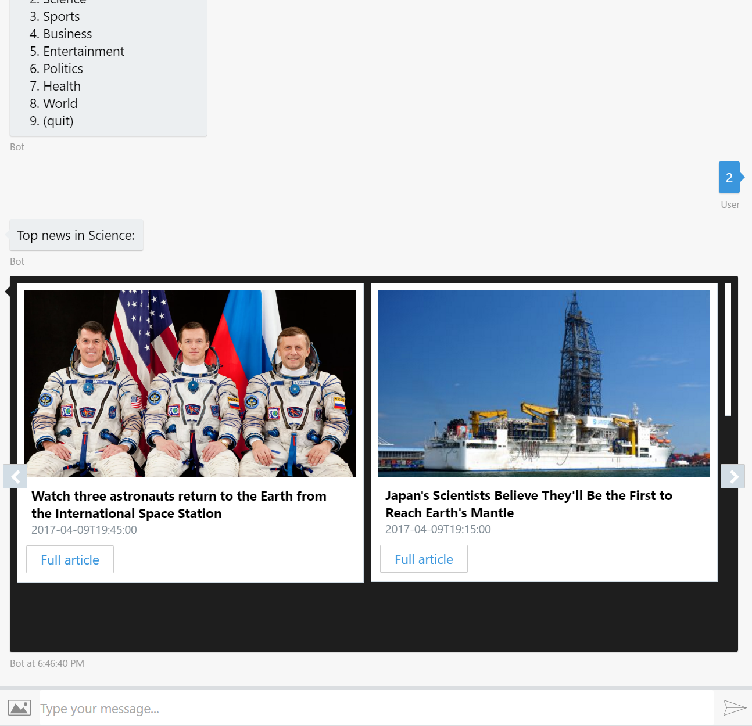
How to consume it News Search scenario
Use a bot to find the news around the world…
Notes:
Bot: (C#) https://docs.botframework.com/en-us/bot-intelligence/search/#example-trending-news-bot
Bot: (Node.js) https://github.com/alyssaong1/HOL-NewsBot
Cognitive Services Bing News site demo: https://www.microsoft.com/cognitive-services/en-us/bing-news-search-api
Intelligent kiosk application: https://github.com/Microsoft/Cognitive-Samples-IntelligentKiosk
See the API Reference for more details on REST API calls

Slide 28
Pricing
https://www.microsoft.com/cognitive-services Click on Pricing
Documentation
https://www.microsoft.com/cognitive-services Click on Docs + Help
Client SDKs and Example Code
https://www.microsoft.com/cognitive-services/en-us/SDK-Sample
Community
https://stackoverflow.com/questions/tagged/microsoft-cognitive
https://cognitive.uservoice.com/
Developer Resources

Slide 30
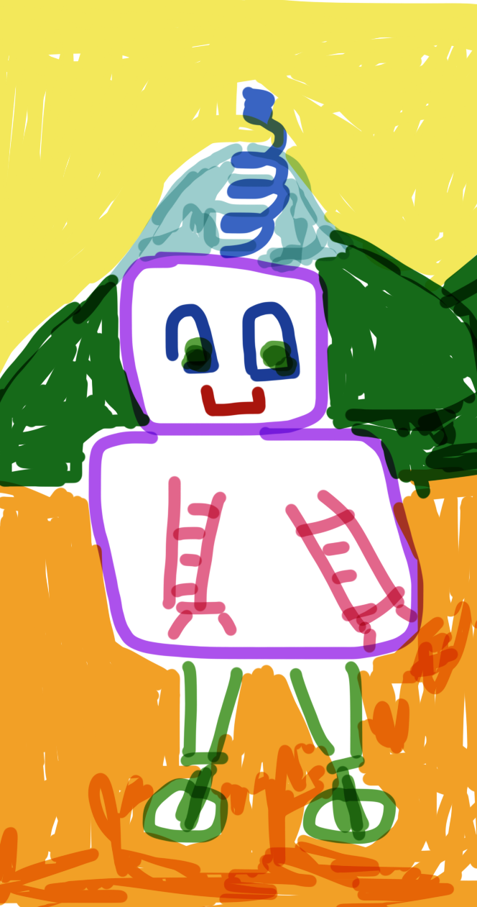
Here enters the Microsoft Bot Framework

Slide 31
What you’ll know at the end of the Bot Framework section
Gain an overview of the tools and resources needed to build a bot with Microsoft’s Bot Framework
Gain the knowledge on how to design a great bot experience
Understand what components make up the Microsoft Bot Framework
See how data works in the Bot Framework
Understand how to deploy a bot as an app to Azure, Microsoft’s cloud

Slide 32
Human language is the new UI
Conversation as a Platform
Bots are the new apps; digital assistants are meta apps
Intelligence infused into all interactions

Slide 33
Bot Framework Scenarios
Answering commonly asked questions for new university students
Recommending talks at a conference
Managing VMs on Azure
Triaging patients in ER based on certain questions using natural language
Bing web search for articles on big events across certain time periods
Chat-based routing to the right product services

Slide 34
The bot life cycle
1. Tangible problem
5. Improve on current bot
2. Ask: How is bot better way
4. Collect bot metrics
3. Get around heavy use of NLP
Notes:
Start by asking what problem are we trying to solve. Refine until it looks like a tangible problem and not “magic”
Ask how a bot will be a better experience. User experience is EVERYTHING
Avoid too much natural language. Careful with unrealistic expectations. Natural language recognition is limited. Menus work great. Commands work great. Buttons, etc.
You can only analyze and improve your bot if you’re collecting metrics for it
Iterate, improve

Slide 35
Notes on designing an experience users will adopt

Slide 36
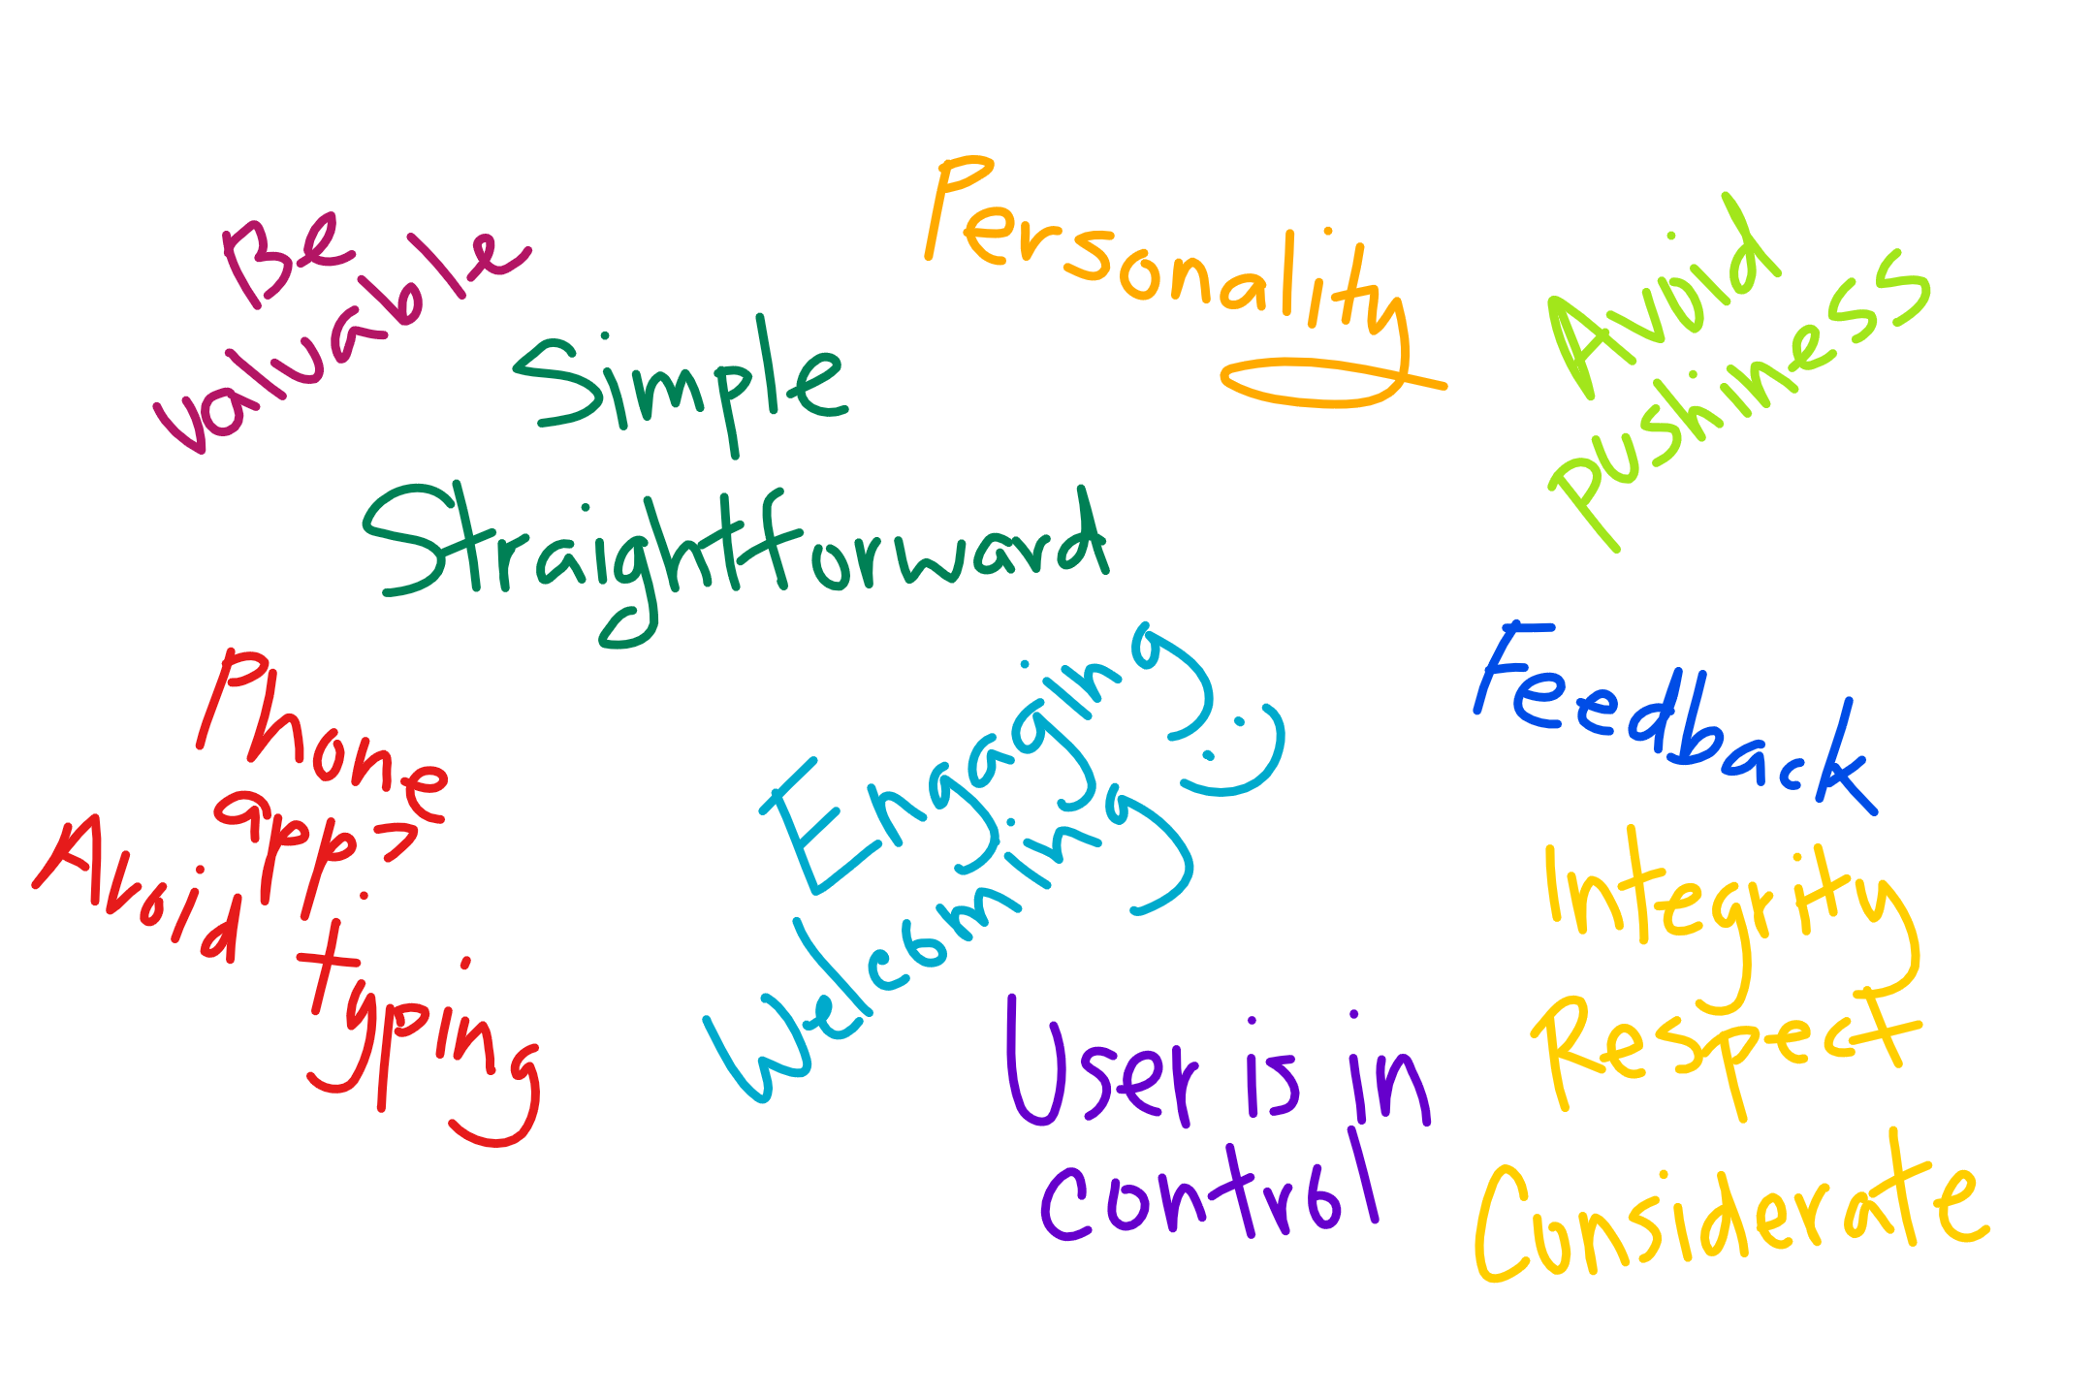
Design aims
Notes:
From: https://docs.botframework.com/en-us/directory/best-practices
This may have been in your mind before this tutorial. Ethical and societal considerations as well in an article by Satya Nadella: https://www.linkedin.com/pulse/partnership-future-how-humans-ai-can-work-together-solve-nadella

Slide 37
Creating an awesome experience: the AI
Key considerations around AI and design today:
Outcomes are determined as much by the human element as by the software element.
Notes:
What does this mean?
The quality of the user experience determines both the usefulness of the product and its rate of adoption, and this is why [it is believed] design is the next frontier of AI.
Credit for paraphrased quotes Manoj Saxena: https://www.fastcodesign.com/3068005/whats-still-missing-from-the-ai-revolution

Slide 39
What is the Bot Framework
A development tool and much more…

Slide 40



Bot Builder SDK
Bot Framework Developer Portal
Bot Directory
Dev
Connect
Publish
Notes:
Bot Builder is itself a framework for building conversational applications (“Bots”).
The Bot Builder SDK is an open source SDK hosted on GitHub that provides everything you need to build great dialogs within your Node.js-, .NET- or REST API-based bot.
The Bot Framework Developer Portal lets you connect your bot(s) seamlessly text/sms to Skype, Slack, Facebook Messenger, Kik, Office 365 mail and other popular services. Register, configure and publish.
The Bot Directory is a public directory of all reviewed bots registered through the Developer Portal.

Slide 41
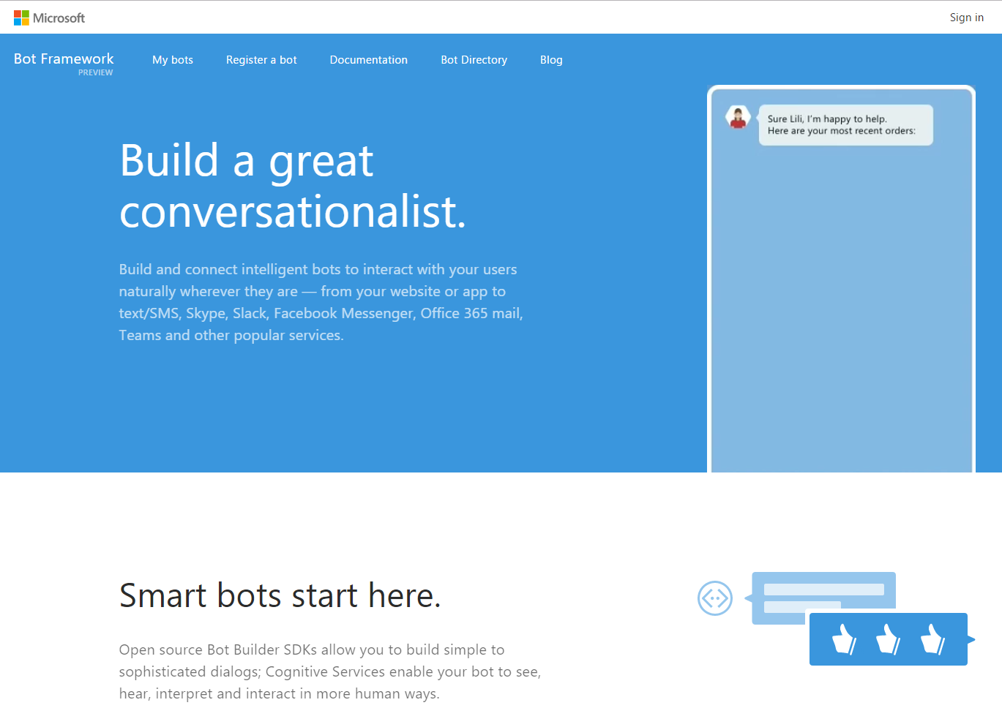






Bot Framework
Bot Developer Portal
Bot Builder Guides
Bot Directory
Notes:
Main page: https://botframework.com

Slide 42
What is the Bot Framework
It’s also a messaging platform
Let’s get a picture of the way it works

Slide 43
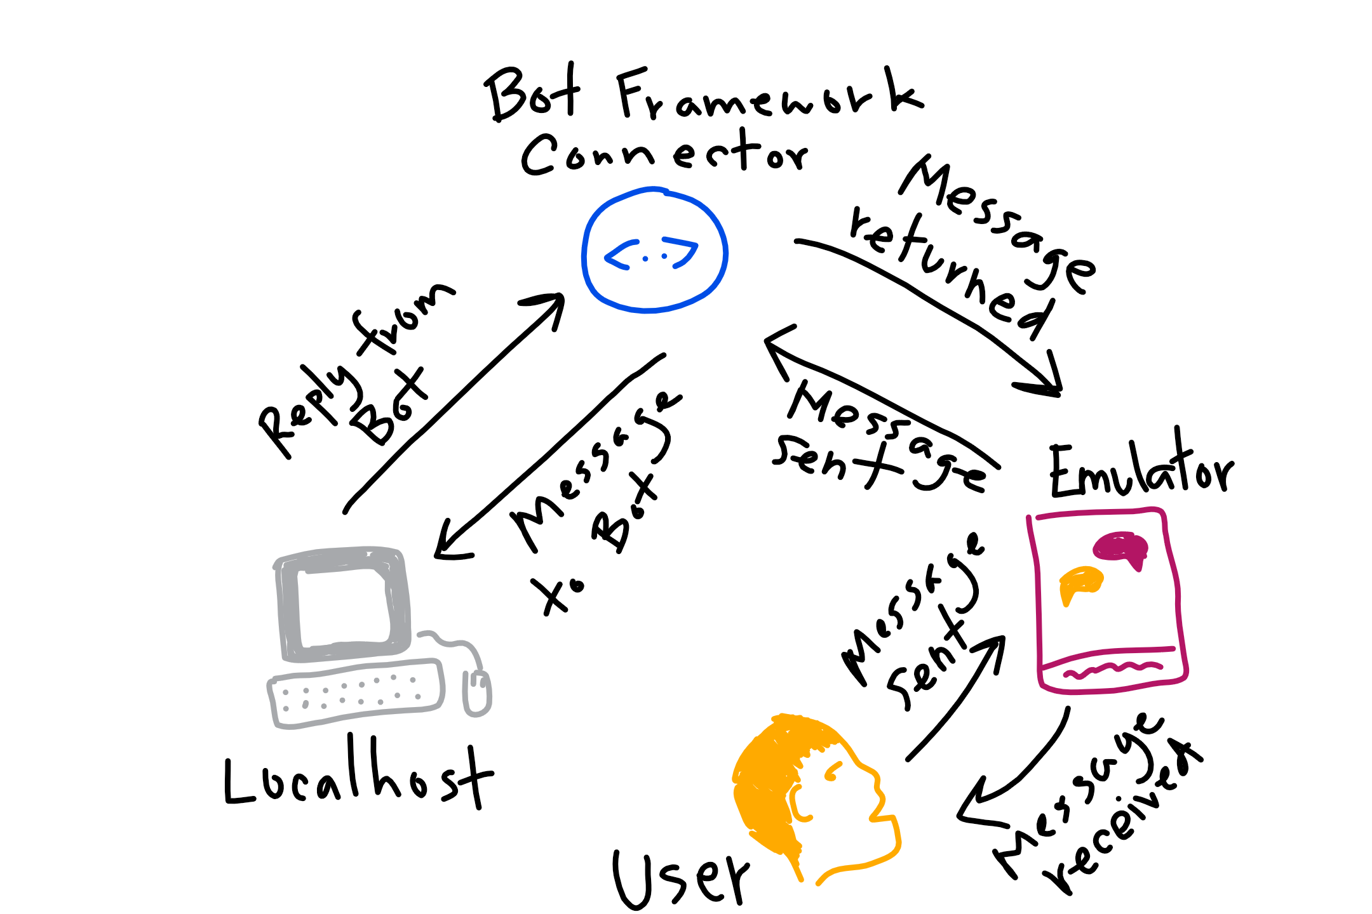





What is the Bot Framework: as a development solution

Slide 44
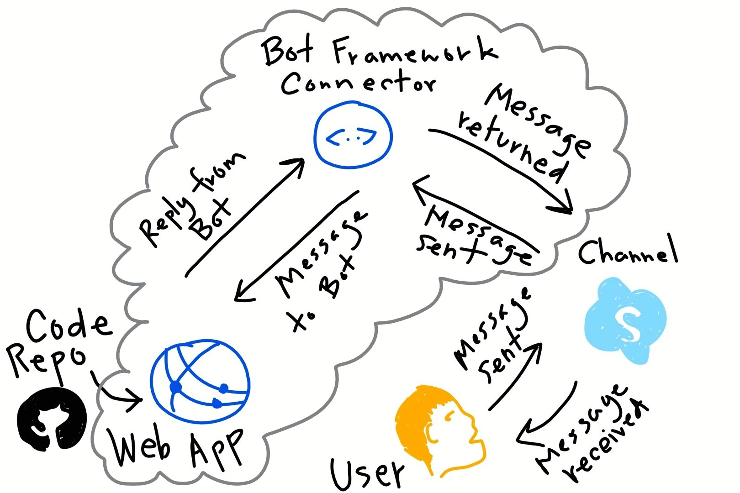
What is the Bot Framework: as a cloud solution

Slide 46









State Service: types of bot data stored for us (part of Bot Connector)
User-conversation data
Conversation data
User data
Dialog data
This data is currently stored for free for you within the Bot Framework State Service.
However, you may bring in your own data source (format: key-value store)
Access with session object in Node
Notes:
User data – globally available for user across all conversations
conversation data – stores globally for a single conversation (many users could be involved)
User-conversation data – stores globally conversation data for a user (But private to just that user)
Dialog data as well – persists for a single dialog (helpful for temp data in a waterfall set of steps)
If I have a bot that plays Blackjack with me, my stats would be stored in user data (would follow me around from game to game), the deck information and stats in the conversation data (i.e. other players could use the same deck), and my hand in a game would be in user-conversation data (my immediate game’s data).
The dialog data persistence ensures that the dialogs state is properly maintained between each turn of the conversation. Dialog data also ensures that a conversation can be picked up later and even on a different machine.
Anything can be stored in these data stores or bags, however it should be limited to data types that are serializable like primitives.

Slide 47


Storage behind the scenes
Bring your own:
Key-Value based storage
Bot Framework state service:
Azure Table Storage
Notes:
The State REST API has wrappers built around Azure Table Storage. NB, you can bring your own storage in the form of a key-value store like Redis Cache, Table Storage etc. The Bot Framework manages this default storage for you so you can maintain a stateless bot experience and if you bring your own, you’ll need to maintain that store and make sure it scales.
Adding your own state example
https://github.com/Microsoft/BotBuilder-Samples/tree/master/Node/core-CustomState

Slide 49
Developing and Deploying Intelligent Chat Bots
Q and A

